Slide 1
A Mixed-Methods Analysis of Virtual Sociology in World of Warcraft
Senior design project in partial completion of Masters of Modeling and Simulation, University of Central Florida
Jordan Dauble, Simon Soschinski, Emmanuel Otero, Rhyse Bendell

Slide 2

Personality, Preferences, and Personal Impact in the Virtual

Slide 3
Overview
Background: Why should we care about video game play?
Context: Does World of Warcraft provide a meaningful test case?
Present Research: How can we quantify the impact of video game play?
End-game: What does this research contribute?

Slide 4
Background: Video Games
Video games have superseded television as the main form of media consumed in first world countries [1]
Increasingly, young people turn to video games to fulfill their desire for hedonic activity
A multiplicity of questions surround the relationship between individuals and their interaction with video games

Slide 5
Background: Video Games
The issue that has dominated the forefront of the debate surrounding the effect of video games is that of violence [2, 3, 4]
Few empirical studies have rendered any meaningful data regarding the issue of the impact of video games on individuals’ behaviors [5, 6]
The prevailing argument seems to be an extension of the one raised against film media: exposure to violence begets violence

Slide 6
Background: Standing Questions
What facets define the relationship between a player and a game?
Can we predict the behaviors of players in game?
Is it possible to extend that prediction to players’ tendencies post-play?
If it is possible to connect predisposition to virtual enaction, and virtual enaction to post-action, can predisposition alone predict post-action?

Slide 7
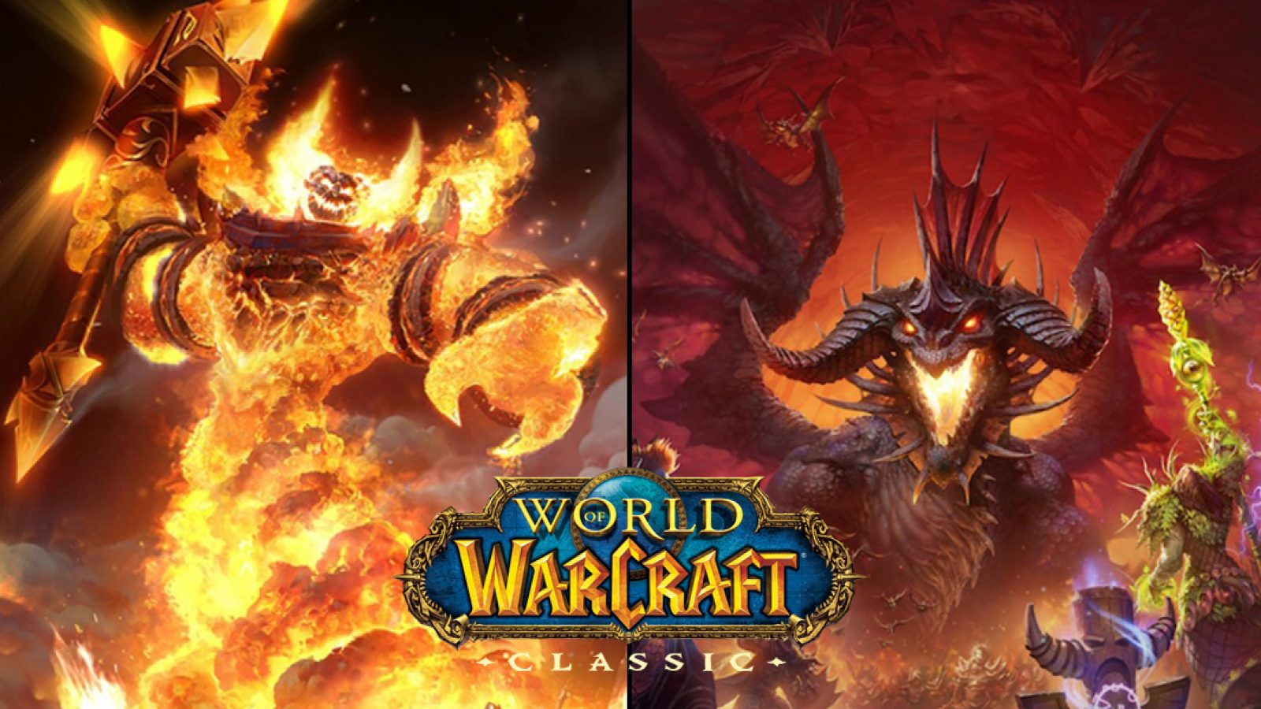

Slide 8
Why World of Warcraft
The World of Warcraft is without doubt one of, if not the, most played massive-multiplayer online role-playing games that has ever existed
The reach and implications of the playership of WoW can only be understated – the community involved in WoW truly spans age, socioeconomic status, motivation to play, and many other measures by which we typically discretize humanity

Slide 9
What is World of Warcraft
Massive-Multiplayer Online Role-Playing Game
The classic game takes place in the world of Azeroth
Players are engaged with in-game struggles such as the battle between the Alliance and the Horde, and for accomplishments and prestige
The overarching theme of the game is that players seek to accomplish successful character building while defeating the challenges presented in the game world

Slide 10


Factions of World of Warcraft

Slide 11
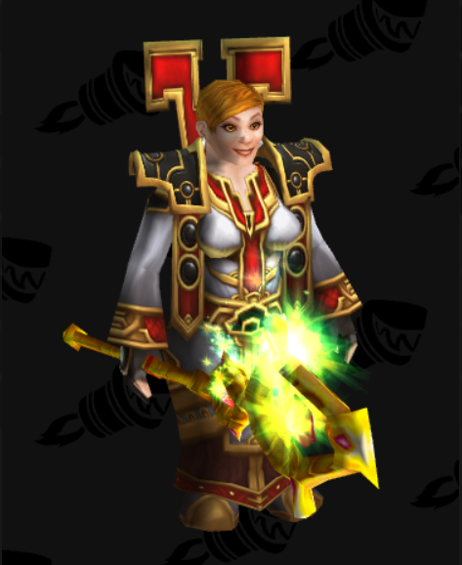
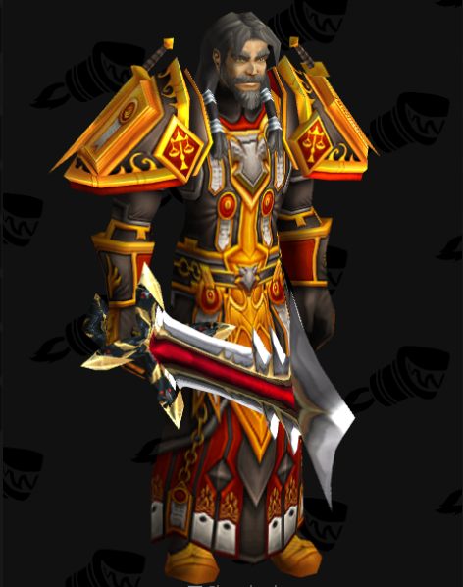
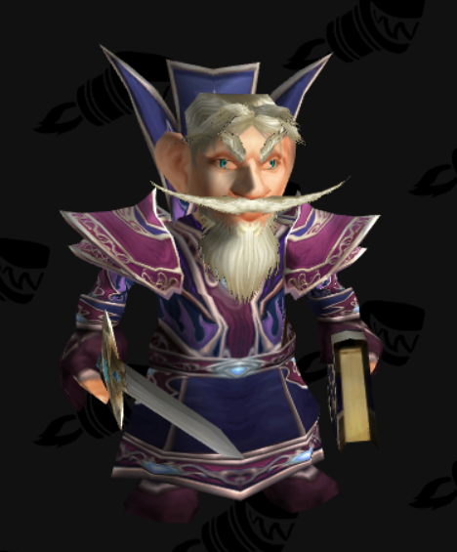
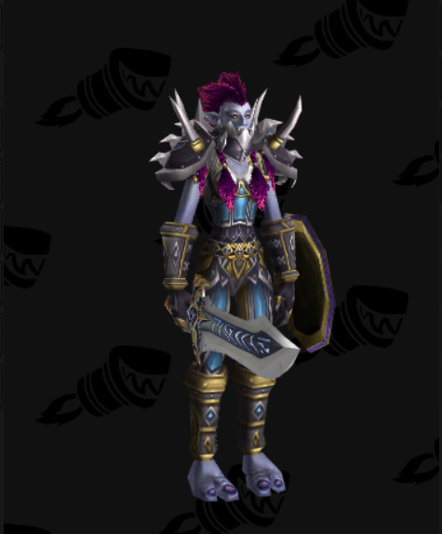
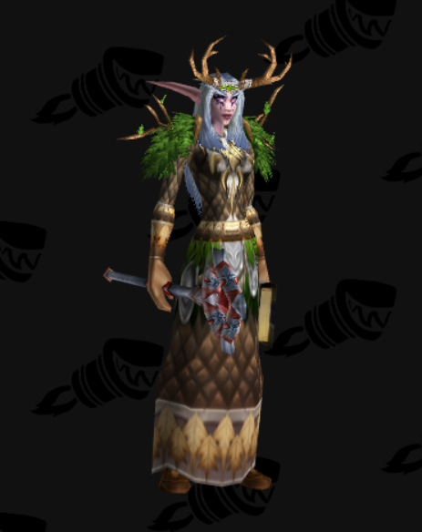
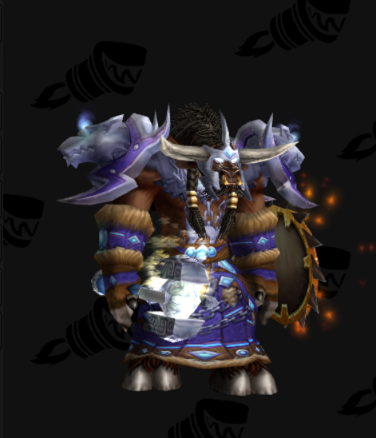
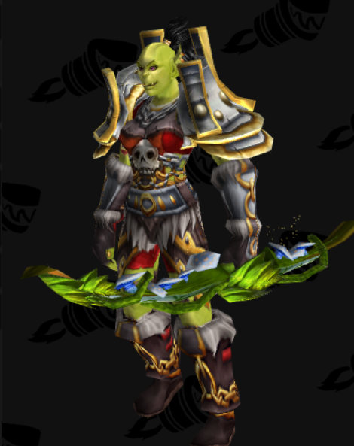
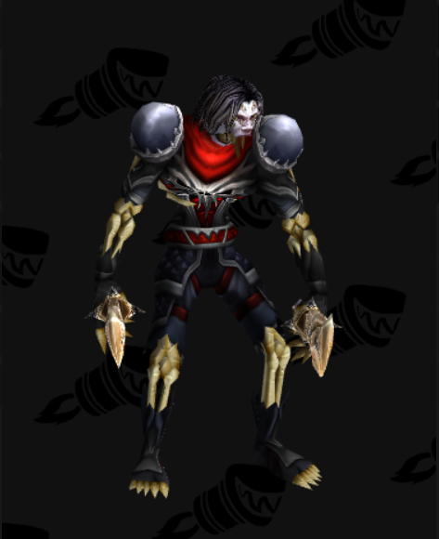
Races of World of Warcraft

Slide 12


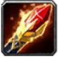
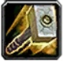
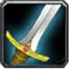
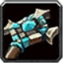



Classes of World of Warcraft

Slide 13
Classes of World of Warcraft

Slide 14
Character Roles IN World of Warcraft
Tank
Frontline in a fight against non-player enemies; use their skillset and toolkit to draw the enemies attentien and have them focus their attacks on themselves
DPS
Deal damage to bring an enemies hitpoints to zero before the healer runs out of mana
Healer
Refills party members’ health pools; enables the party to keep going with the fight and also safes his allies should they be carelessly taking damage.

Slide 15
Play-Styles IN World of Warcraft
Player versus Environment
focuses on besting enemies not controlled by other players but by the game
Player versus Player
players tend to compete with other players in different competitions
Role playing
focusing more on embodying their character and socialize within the game world

Slide 16
Scientific Approach

Slide 17
Why Personality and WoW?
Bean and Groth-Marnat built upon previous findings to show that personality measures can predict play-style choices in WoW (7)
Additionally, individual items of the Big-Five Index were associated with players’ biological sexes
The findings of their study may have been obscured by the number of choices available to players as well as non-directional hypotheses

Slide 18
Why This Research?
This work aims to predict WoW players’ biological sex, chosen character sex, chosen alignment, chosen class, and preferred play-style with additional consideration of the effect that player recurrence may have on the BFI model’s predictive power
We will build directly on the findings of Bean and Groth-Marnat (2016) and include additional measures which have the potential to reveal effects that may have been obscured in the previous research

Slide 19
Methods

Slide 20
Experimental Design
This study includes one independent variable (Character creation intentionality) to determine whether personality and motivation factors can meaningfully map onto decisions made during character creation
Group A will be asked to respond to World of Warcraft character creation probes as if they were faithfully recreating themselves in the game
Group B will be asked to respond to the same probes as if they were creating a new character of their own devising

Slide 21
Experimental Design
Specifying intention in the character creation process may yield insight into the goals underlying decisions as well as whether personality and motivation factors are meaningful predictors
IV1 | DV1 | DV2 | DV3 | DV4
A: Self-representative | Race | Class | Role | Play Style
B: Novel | Race | Class | Role | Play Style

Slide 22
Demographics

Slide 23
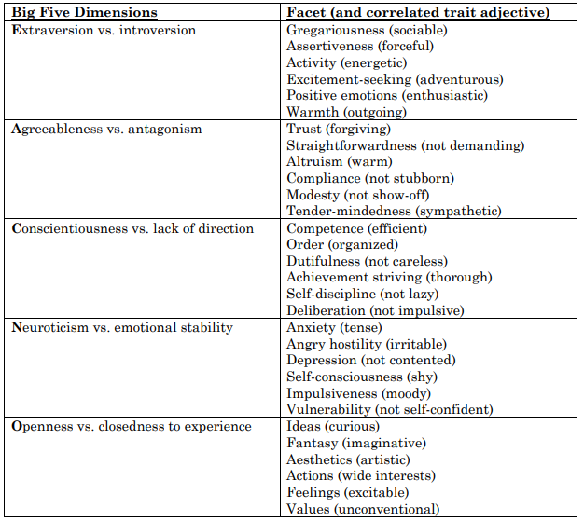
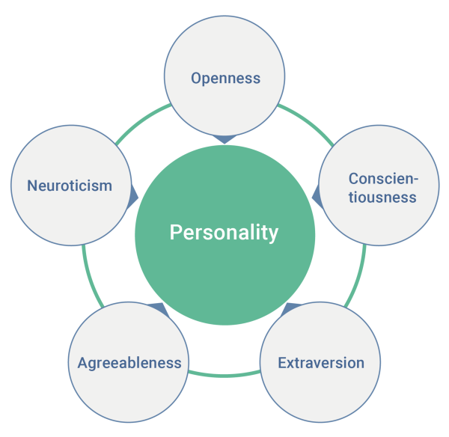
BFI Test

Slide 24
Motivation to play Online Games

Slide 25
Hypotheses
H1: Responses to WoW probes regarding designing a character with which they identify will be predicted by BFI measures with larger effect sizes than responses based on players’ main characters.
H2: A combination of higher Extraversion scores, lower Agreeableness scores, lower Neuroticism scores, and lower Openness scores will predict players’ biological sex such that those scores will correspond with male respondents (.)

Slide 26
Hypotheses
H3: A combination of higher Extraversion and lower Neuroticism scores will positively predict player preferences towards PvP play-styles as opposed to RP or PvE.
H4a: Participants’ personality traits will predict their free-responses to queries regarding race and class.
H5: Participants’ personality traits will predict their responses to reduced-choice forced queries regarding race and class.

Slide 27
Hypotheses
H6: A combination of increased Conscientiousness scores, increased agreeableness scores, and decreased Extraversion scores will predict players’ alignment such that those exhibiting those traits will be more likely to align with Alliance forces than the Horde.
H7a: Participants’ responses to the motivation to play online games scale with predict their choices of play style
H7b: Participants’ responses to the motivation to play online games scale with predict their choices of character role

Slide 28
Data Analysis

Slide 29
References
(1) Billieux, J., Van der Linden, M., Achab, S., Khazaal, Y., Paraskevopoulos, L., Zullino, D., & Thorens, G. (2013). Why do you play World of Warcraft? An in-depth exploration of self-reported motivations to play online and in-game behaviours in the virtual world of Azeroth. Computers in Human Behavior, 29(1), 103-109.
(2) Bean, A. M. (2015). Video gamers' personas: A five factor study exploring personality elements of the video gamer. Pacifica Graduate Institute.
(3) Bean, A. M., Ferro, L. S., Vissoci, J. R. N., Rivero, T., & Groth-Marnat, G. (2016). The emerging adolescent World of Warcraft video gamer: A five factor exploratory profile model. Entertainment Computing, 17, 45-54.
(4) Crawford, J., Brandt, M. (2019). Who is prejudiced, and toward whom? The big five traits and generalized prejudice. Personality and Social Psychology Bulletin, 45(10), 1455-1467.
(5) John, O. P., & Srivastava, S. (1999). The Big-Five trait taxonomy: History, measurement, and theoretical perspectives. In L. A. Pervin & O. P. John (Eds.), Handbook of personality: Theory and research (Vol. 2, pp. 102–138). New York: Guilford Press.
(6) Kaspi-Baruch, O. (2017). Big Five Personality and Creativity: The Moderating Effect of Motivational Goal Orientation. The Journal of Creative Behavior, 53(3), https://doi-org.ezproxy.net.ucf.edu/10.1002/jocb.183
(7) Bean, A., & Groth-Marnat, G. (2016). Video gamers and personality: A five-factor model to understand game playing style. Psychology of Popular Media Culture, 5(1), 27.

Slide 30
Questions

